Slide 1

Difficulties of Timestamping Archived Web Pages Mohamed Aturban, Michael L. Nelson, and Michele C. Weigle Presented by Peter Foytik
Aturban, Mohamed, Michael L. Nelson, and Michele C. Weigle. "Difficulties of timestamping archived web pages." arXiv preprint arXiv:1712.03140 (2017).

Slide 2
High Level Topic of Paper
Web archived sites are run by many organizations
Everyone has some archived sources that they trust (maybe some they don’t)
We often take for granted this trust
What types of vulnerabilities exist with web archival systems?
Can Blockchain be a solution?
What are the list of requirements needed to achieve this solution?

Slide 3
Information Security "CIA" Triad
Confidentiality
Integrity
Availability

Slide 4
Information Security "CIA" Triad
Confidentiality
Integrity
Availability

Slide 5
Background of Wayback and Memento
The paper covers the background
on the use of the Wayback Machine internet archive
and the value and use of the Memento HTTP protocol extension
4 URI teminology used:
URI-R: identity of an original resource from the live Web
URI-M: identity of an archived version (memento) of the original resource at a particular point in time
URI-T: a resource (TimeMap) that provides a list of mementos (URI-Ms) for a particular original resource
URI-G: a resource (TimeGate) that supports content negotiation based on datetime to access prior versions of an original resource

Slide 6
Types of Attacks/Vulnerabilities
Four Types of Vulnerabilities of the Wayback Machine are described referenced from Lerner et al.
Archive-Escapes
Same-Origin Escapes
Archive-Escapes + Same-Origin Escapes
Anachronism-Injection
Lerner, A., Kohno, T., Roesner, F.: Rewriting history: Changing the archived web
from the present. In: Proceedings of the 16th ACM conference on Computer and
Communications Security (CCS) (2017)

Slide 7
Archive-Escapes
URL rewriting occurs for archived web pages
All URL's are re-written to point to archived version of the links
When URL's are incorrectly re-written or not re-written
users snapshot view of the archive might be wrong
containing some archived content and some live content
If the link is to the live web "Escaping the archive" then it could point to malicious scripts or content

Slide 8
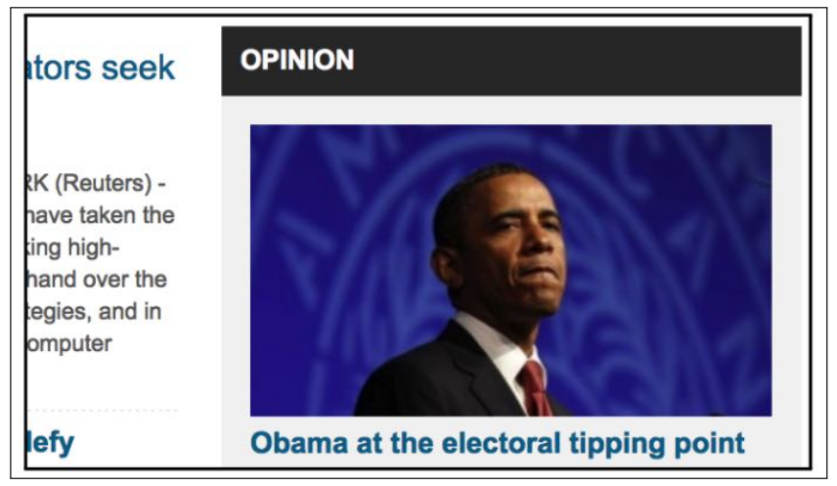
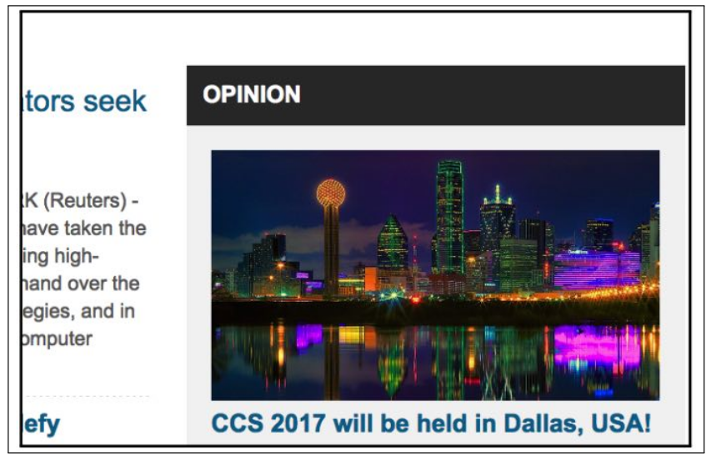
Example Archive-Escape
Image could be incorrectly referenced in an archive
Top image shows the correct image
Bottom image is of the archive with the link pointing to an incorrect image pointing outside the archive

Slide 9
Same-Origin Escapes
Archives save content that comes from all domains of the web page at the time
Additional domains such as sources of advertisements can also be collected
In live web pages iframes prevent third parties from accessing or modifying data
The policy of preventing the cross-origin access is called the same-origin policy
Same-origin is ineffective in the archival context
In archives, code within embed iframes are now executable from a single domain

Slide 10
Archive-Escapes + Same-Origin Escapes
Combination of Archive-Escapes and Same-Origin Escapes
The attacker first utilizes the same-origin vulnerability in the iframe at the time of archival
Then the attacker can redirect the archival link through the iframe manipulation to outside links making an archive-escape

Slide 11
Anachronism-Injection
When client browsers are redirected to timestamps very far in time from the original page
Wayback machine will attempt to reproduce a snapshot in time with all web elements
when time of archive not available, attempt to utilize a version in time with the smallest delta in time

Slide 12
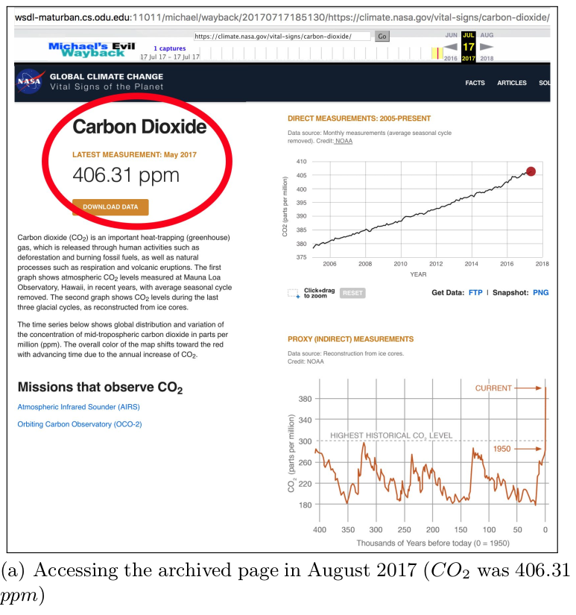
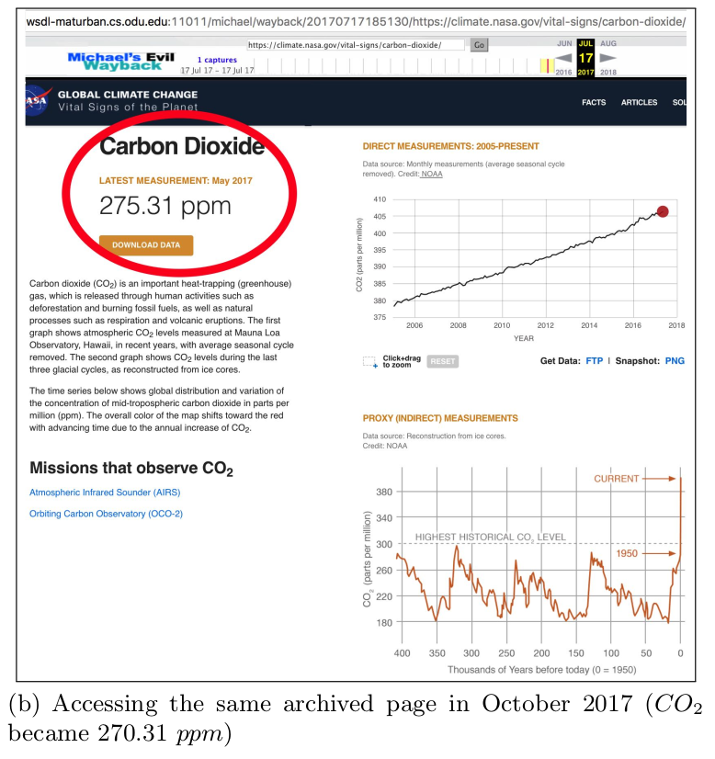
The Evil Wayback Machine
How can we independently verify the archived website we are looking at?
Can we do this without requiring the trust of a 3rd party?
3rd party includes:
Trusted authority to say it is true
Many redundant sources to verify truth

Slide 13
Cryptography and Blockchain Background

Slide 14
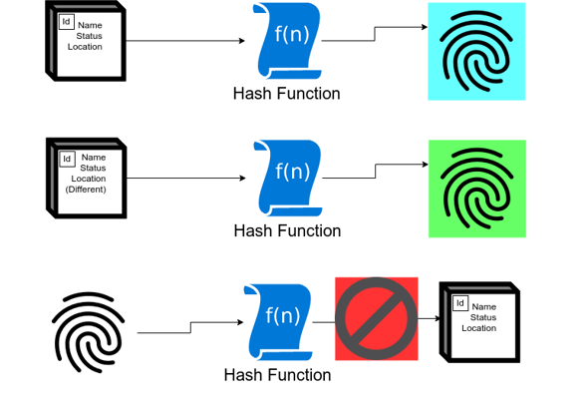
Hash Function Background
Publicly known function
One to one representation
Not Reversable
Compressed fixed length output
Integrity is everything
The state of being unimpaired; soundness.
Some Uses:
Checksum
Check digits
Fingerprints

Slide 15
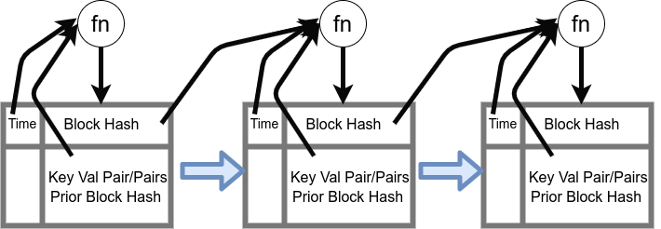
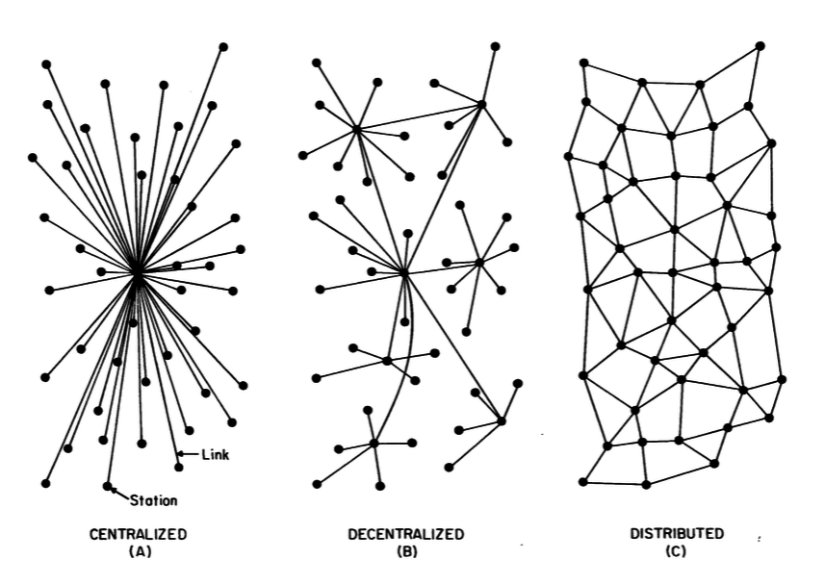
Blockchain Background
Simply a ledger
Records in time
Tracks states or identities
Merkle Tree/ Hash Tree
Hash of Hash
Centralized vs. Decentralized
Self Soverignty
Requires a consensus protocol to specify the order of transactions
Foytik, Peter, and Sachin S. Shetty. "Blockchain Evaluation Platform." Blockchain for Distributed Systems Security (2019): 275-310.
Baran, P. (1964). On Distributed Communications, Memorandum RM-3420-PR.

Slide 16
Bitcoin Blockchain and its Consensus
Really the only "at scale" production blockchain system
Transaction Order is determined by a computational race
Who can guess the best hash value first! (proof of work)
"Best hash" gets harder based on the hash power of the network
Difficulty adjusts in order to keep block rate near 10 minute intervals
New transactions build on the longest chain that the miner sees
Inevitably longest chains will always succeed
Short chain transactions will need to re-work to add to the longest chain
Important point to how Nakamoto consensus works
Nakamoto, S.: Bitcoin: A peer-to-peer electronic cash system (2008), https://bitcoin.org/bitcoin.pdf

Slide 17
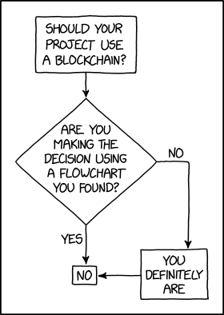
Blockchain Use
Blockchains are often talked about as "the new solution to everything"
Blockchains do not:
Add privacy
Add security
Add confidentiality
Add performance
Act as a new database
Blockchain technology brings one aspect to the tech toolbox
Decentralized Integrity
"Blockchains are like grappling hooks, in that it's extremely cool when you encounter a problem for which they're the right solution, but it happens way too rarely in real life."
https://xkcd.com/2267/

Slide 18
Existing Solutions to these problems
OriginStamp
Allows users to submit plain text, a hash value, or any file format
The data is stored in the user's browser
The hash is then sent to the OriginStamp server
Once a day OriginStamp transacts a hash of all the hashes it has received to the bitcoin network
The user can then verify the text or file is authentic by comparing it to the hash stored on the bitcoin ledger (query'ed through OriginStamp API or their website)
Others include
Chainpoint, Tangible.io, Proof of Existence, and OpenTimeStamps

Slide 19
Papers Questions and Exploration
Web Archiving today is a system that is for the most part many independent centralized servers
We currently trust the hosts of the centralized servers
Can a cryptographic protocol that allows us to prove historical content without the need to trust a third party be built or utilized?
What requirements would the archiving community have for a system that cryptographically verifies the web content?
8 Requirements are derived and presented

Slide 20
Archive Requirements for Blockchains

Slide 21
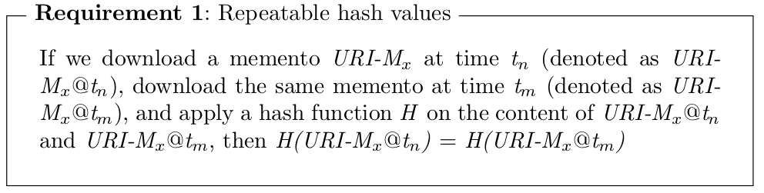
Requirement 1: Repeatable Hash Values

Slide 22
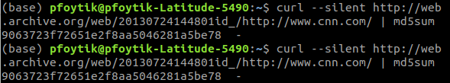
Example Requirement 1: success
Hash functions can quickly produce values for the raw html content of an archive
Appending the id_ tag at the end of the date provides results of raw html from web.archive.org
Hash functions show that grabbing the same raw html of an archive at different times produces the same Hash value
Below is an example of cnn.com archive for july 24, 2013 and its associated md5 hash value
The hash was generated at different times producing the same hash value (highlighted)

Slide 23
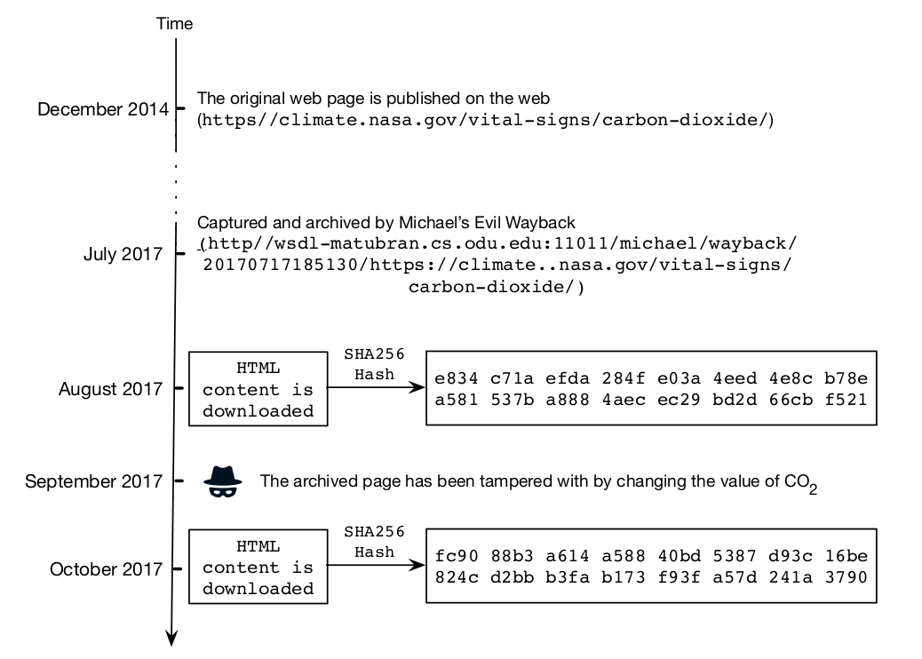
Example Requirement 1: unsuccess
For HTML content only the hash value can be obtained
If changes are made to the archive a completely different hash function is generated
Easily shows that a change has been made

Slide 24
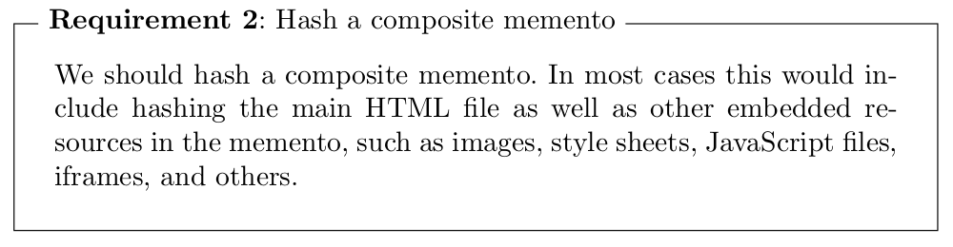
Requirement 2: Hash a Composite Memento

Slide 25
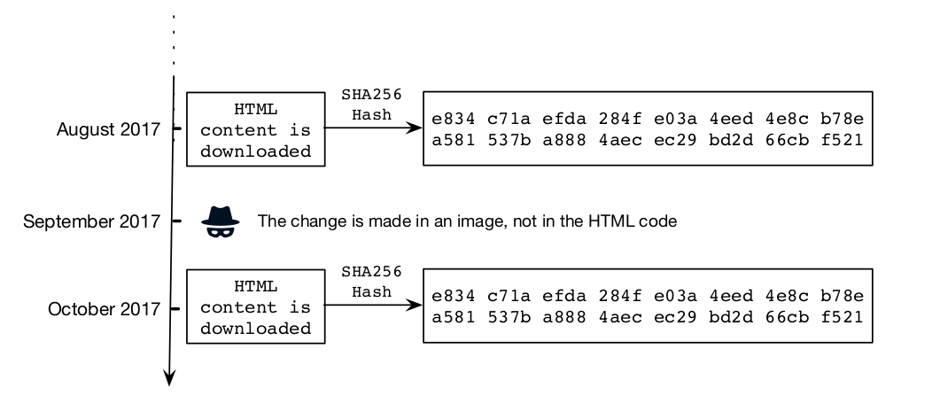
Example Requirement 2: unsuccess

Slide 26
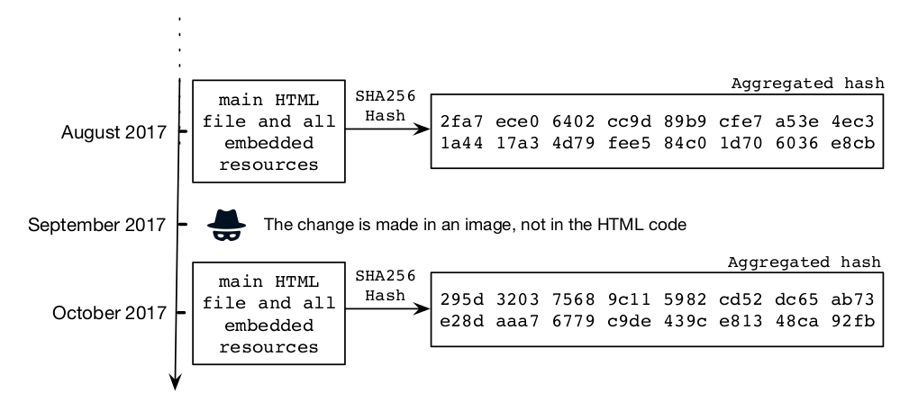
Example Requirement 2: success
An aggregated hash is utilized
Each element in the html is hashed from its source
The hash values are then combined in a single hash value
A Hash of the Hash values
Scripts exist to support this generation process

Slide 27
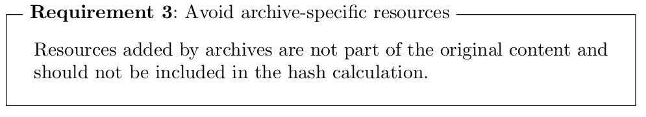
Requirement 3: Avoie Archive-Specific Resources

Slide 28
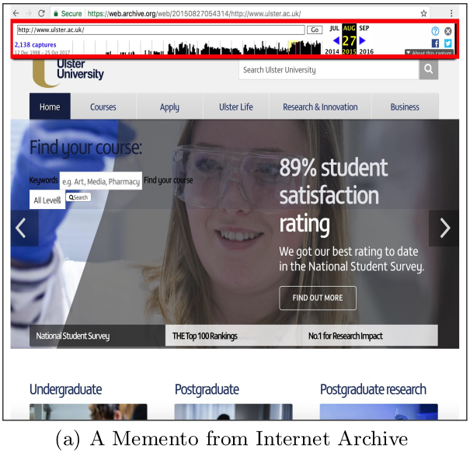
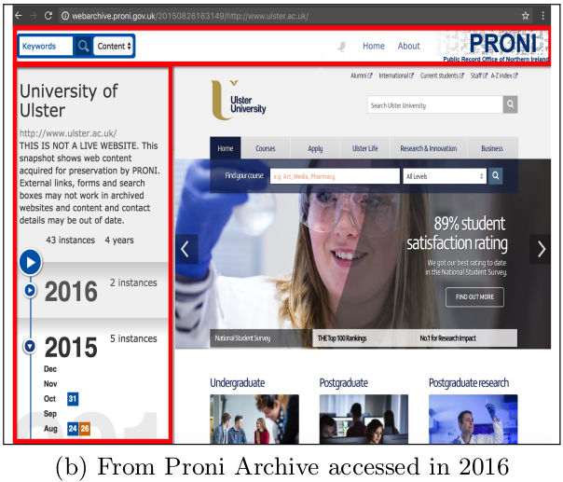
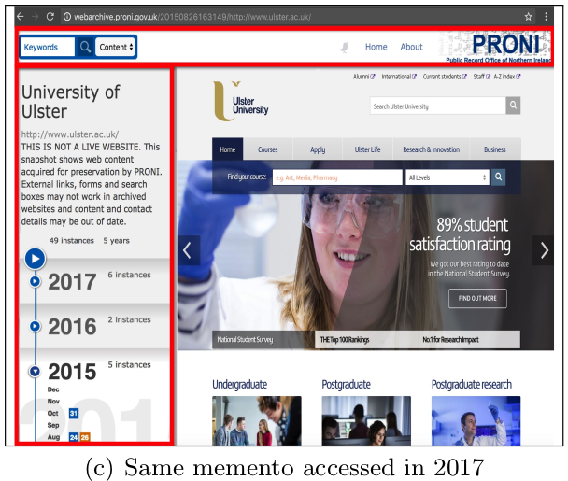
Example Requirement 3
Archival systems provide user interfaces and banners that should not be part of the hash
The hash should only represent the content that needs to have the integrity check

Slide 29
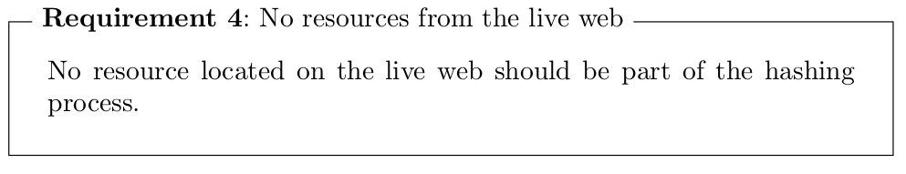
Requirement 4: No Resources From the Live Web

Slide 30
Example Requirement 4: archive-escape
Some URIs are not rewritten
Produced dynamically
Events triggered by client-side JavaScript
These are often retrieved from the live web

Slide 31
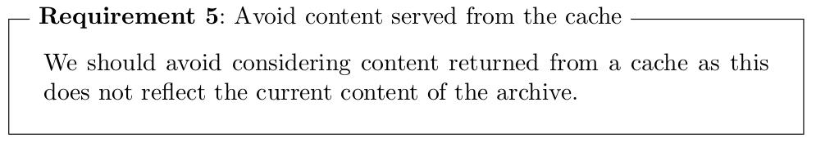
Requirement 5: Avoid Content Served From the Cache

Slide 32
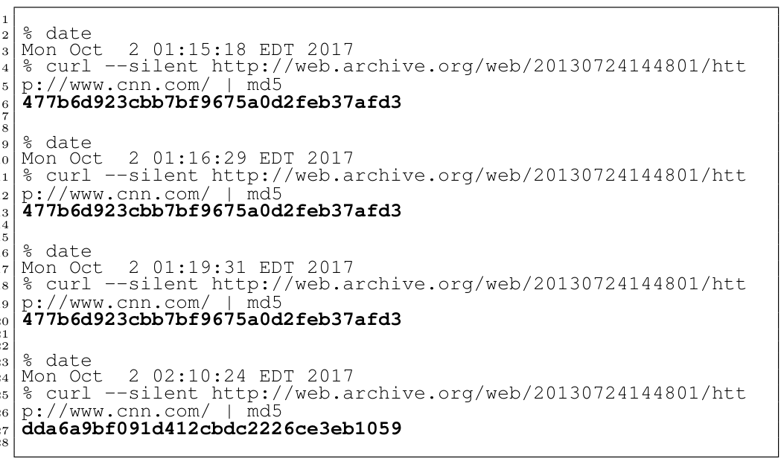
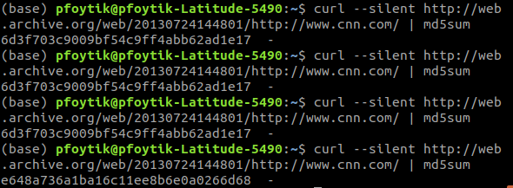
Example Requirement 5: issue
Wayback machines https response header indicates cacheing
"X-Page-Cache" indicates if the content is cached
X-Page-Cache: Hit
X-Page-Cache: Miss
Cache hit can produce same hash value even though the actual archive might be different
Below shows when not using id_ tag the hash value is the same when used frequently
After a period hash value is different

Slide 33
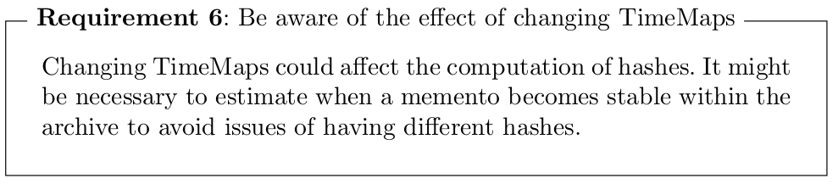
Requirement 6: Be Aware of the Effect of Changing TimeMaps

Slide 34



Example Requirement 6: details
Archives attempt to match archived elements to the closest time
Date and time is encoded in the archive links
The archived content for the associated elements can change

Slide 35
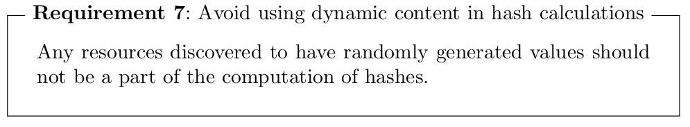
Requirement 7: Avoid Using Dynamic Content in Hash Calculations

Slide 36
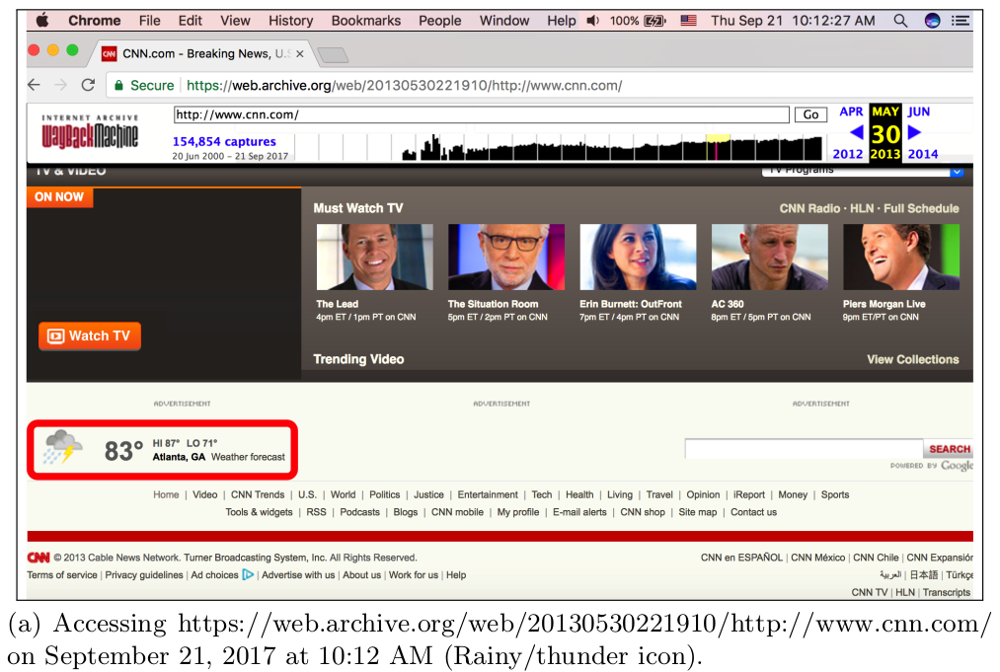
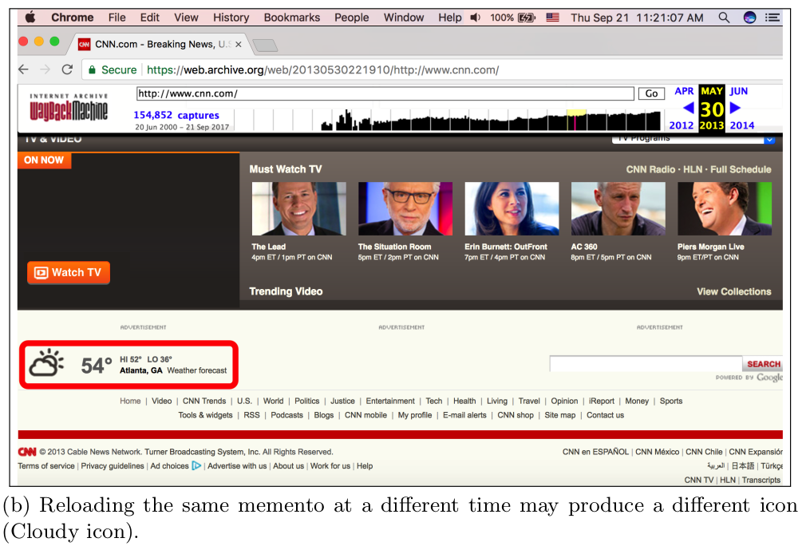
Example Requirement 7: Archive-Escape

Slide 37
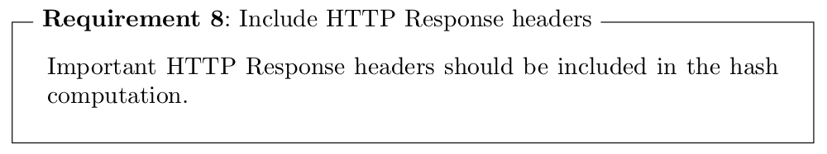
Requirement 8: Include HTTP Response Headers

Slide 38
Example Requirement 8: discussion
If important HTTP headers are subject to change then the hashing will be different
For situations where content type has changed
where images have been converted to different formats
"X-Page-Cache" has changed
HTTP Response header "Location"
Do we need these headers to prove that the content has not changed of the archive?
If the image has changed (for good or bad) we should know and a new archived hash should be stored
Should this be compared in order to determine change in the archive?
This is used to obtain the status code "3xx" does this need to be hashed in order to know if archive has changed?

Slide 39
Conclusions
Importance of timestamping archived web pages
State of the art timestamping services in blockchain-based networks do not allow users to submit URIs of web pages in order to establish trusted timestamps.
Difficulties exist in timestamping archived web pages (I.e. mementos)
Archived pages will not be directly timestamped in the blockchain, instead a hash value calculated on the content of the memento is the data to be timestamped

Slide 40
Finally...
Blockchains do not strive to prove authenticity, only integrity
Garbage in.... Garbage out....
All that integrity will give you is certainty that the garbage out is the the same as the garbage in...
This is still very valuable but needs to be used in the right way
It will not solve all problems
It will help independently verify that (non-changing) contents have not been altered since being archived
In web archiving there are many pieces to an archive, each of these pieces need to be checked for integrity
As these pieces are combined the pieces can be checked individually as well as the combination

